Slide 1
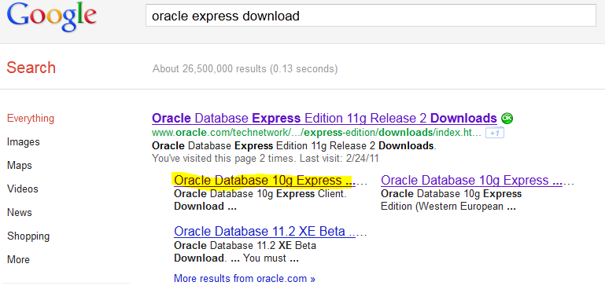

Slide 2
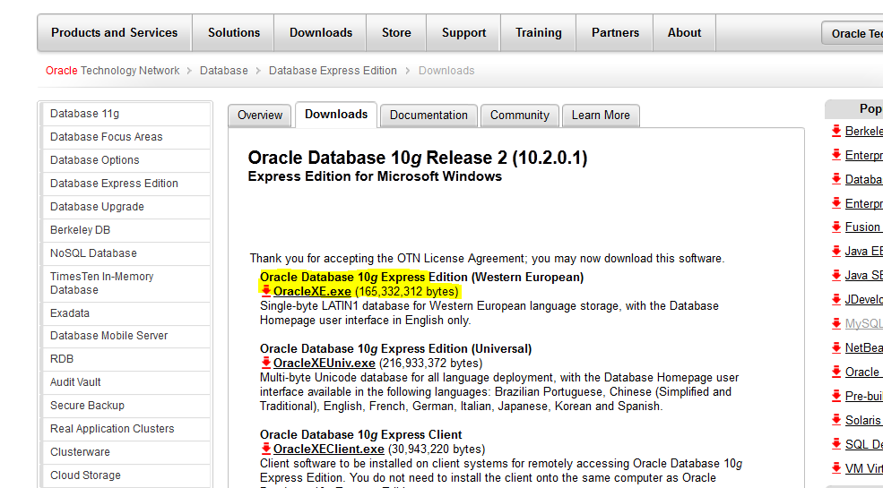

Slide 3
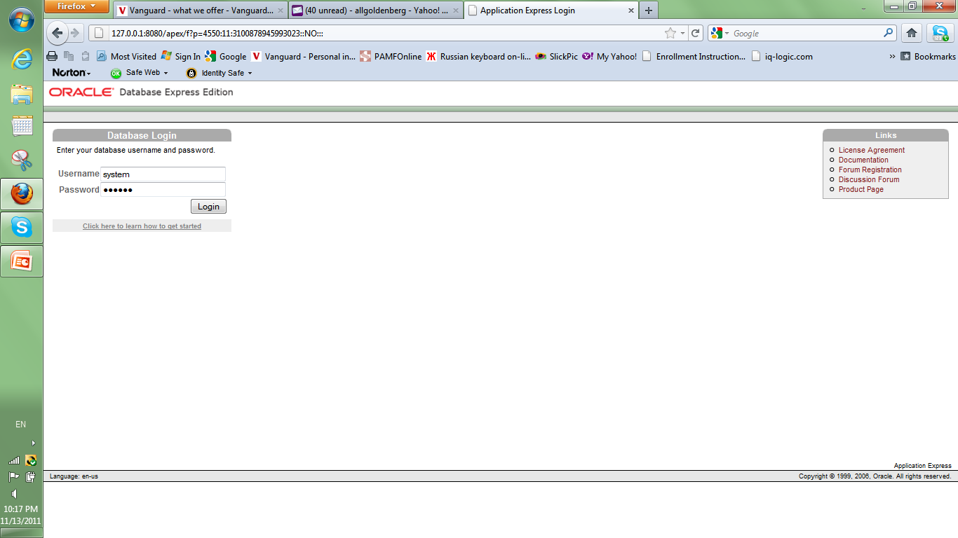
Enter Password used during ORACLE installation

Slide 4
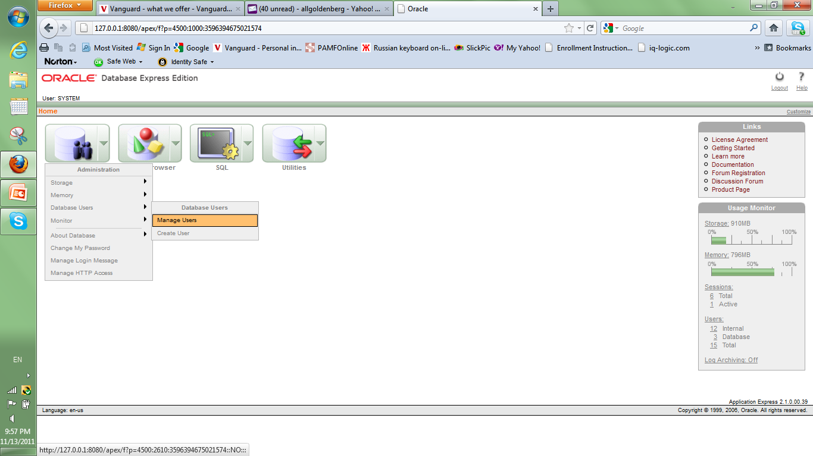

Slide 5
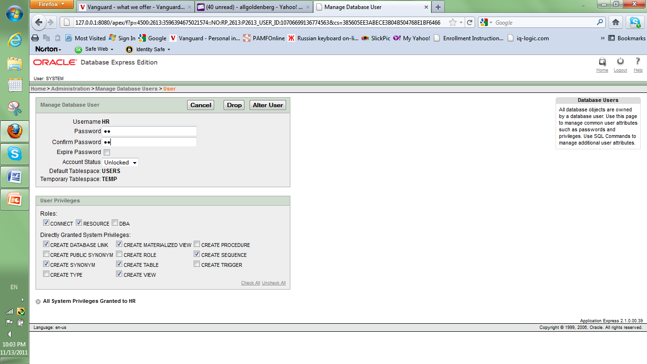
4. Click Logout
3. Click Alter User
1. Enter PW: hr
2. Check the privileges

Slide 6
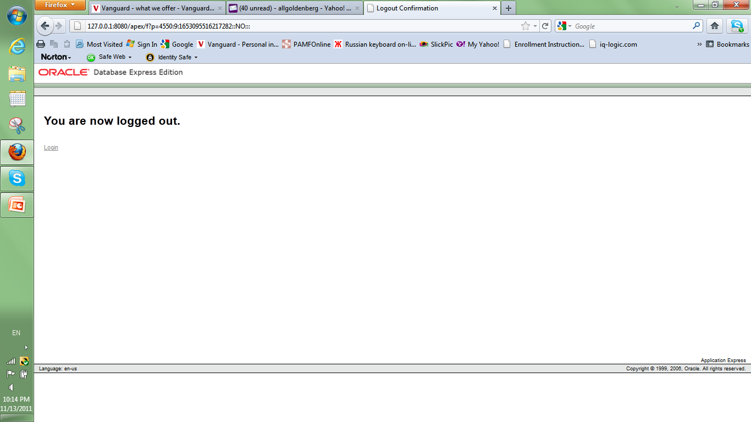

Slide 7


Slide 8
